Slide 1

„Digitalisierung im Retail – Wieviel IT ist richtig für den Handel?“
i2s consulting
Webinar
20. Oktober 2023

Slide 2
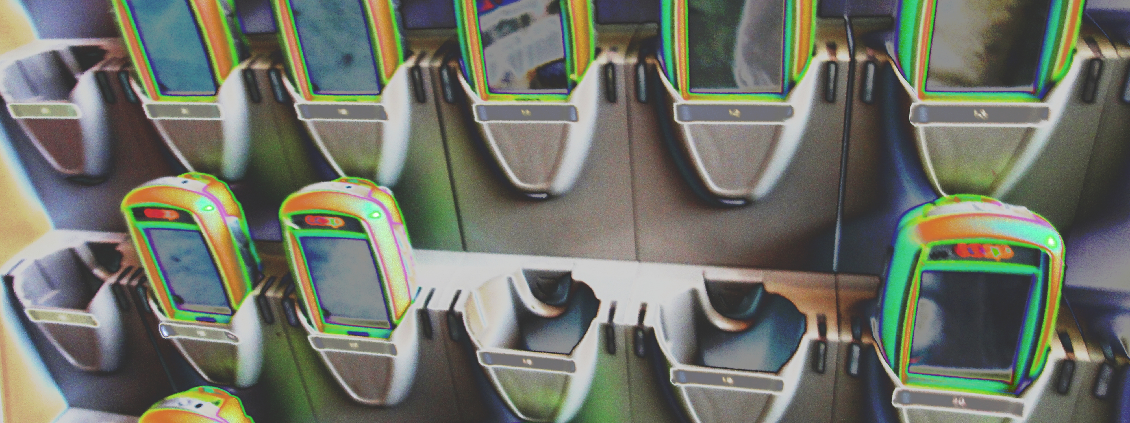
Retail & E-COMMERCE
i2s consulting

Slide 3
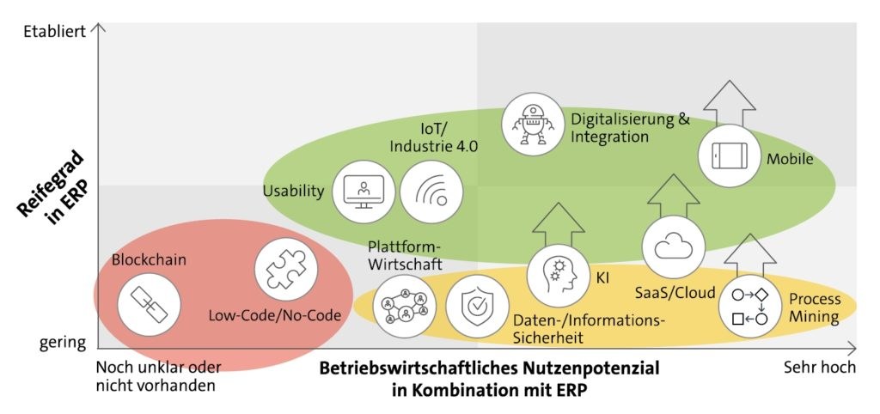
Technologietrends für ERP-Systeme
Quelle: Bitcom 2021

Slide 4
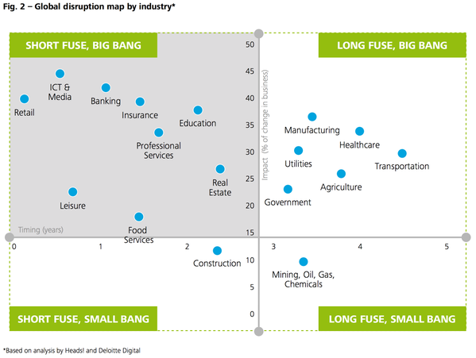
The impact of technological change in it towards retail
New technologies have a major impact on retail
The timespan for implementation is short
Role of «disruptive» technologies on
different industries
(Source: Deloitte Consulting)
Quelle: Deloitte Consulting

Slide 5

Das Dilemma im Retail
Systems
follow
strategy
IT DRIVEN
Business
potential

Slide 6
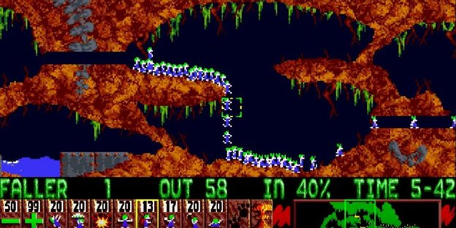
IT-Strategien im Handel 2023?
Wie die Lemminge …
Böndel,‘‘Wie Lemminge’’, Wirtschaftswoche, 49/12, 1995

Slide 7
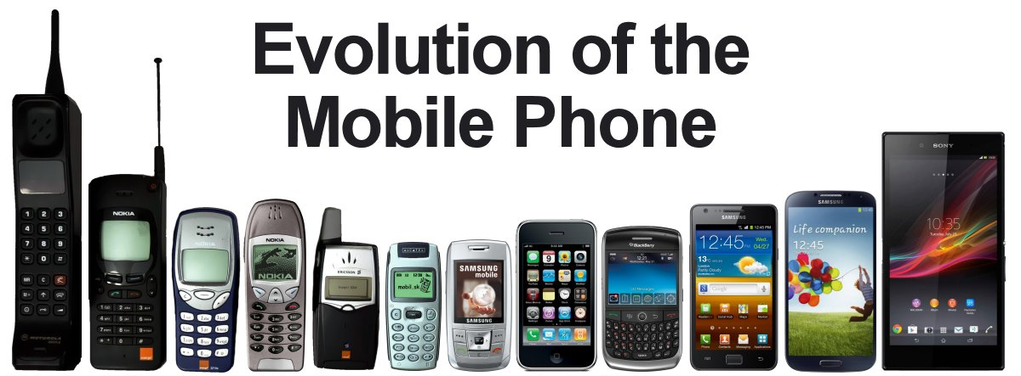
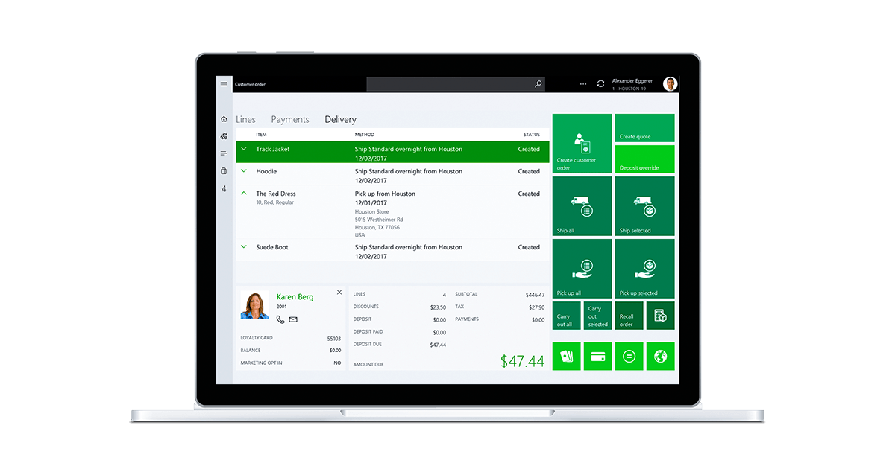
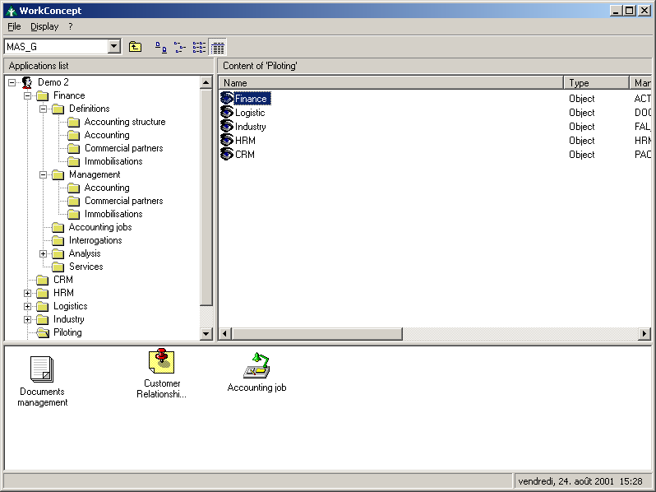
Ist Das eigene ERP-System noch aktuell?
Technologischer Fortschritt
ERP 2002
ERP
2023
Weitgehend erweiterte Funktionalität
Cloud ready
Mobile ready
Einfache Bedienung

Slide 8

Fit for the future im retail
i2s consulting

Slide 9
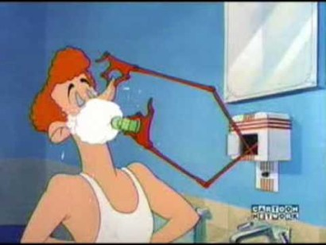
I2s’ vision of «the future» in retail and erp:
As we all know, the «Future» is somewhat unpredictable. Therefore I2S strongly believe, that usually things evolve differently then originally thought. Our strategy therefore is «Be ready for the future». «Future readiness» of a strategy and design can be proofed by checking against any probable but also improbable and even unthought scenario.
Still, as retail is today, «future retail» will be dependent on technology, on customers and society’s trends. Thus flexibility and the ability to change will maintain a core role in future retail.
Tex Avery's 1949 short 'The House of Tomorrow’
shows a vision of the future, which we now all know never came true. Still he indicates two key features still driving innovation today: (1) technological innovation, and (2) consumer orientation

Slide 10
Fazit
Man kann sich den Erfolg in der Zukunft nicht kaufen,
aber man kann bereit für die Zukunft sein.

Slide 11

Zielsetzung: Die Welten versöhnen
Klassische ERP-Welt
Strukturierte Geschäftsprozesse
Betriebswirtschaftliche Buchungslogik
Klare Strukturen
Compliance
Abdeckung der regulatorischen Anforderungen
Standardisierung
Stabilität
Robustheit
Lange Laufzeiten
Unternehmens-zentriert
Digitalisierung
Einfach
Schnell
Flexibel
Ständige Adaption
Agil
Experimentell
«unsauber»
Kurze Nutzungszeiten
User/Kunden/Klienten-zentriert

Slide 12
Systemlandschaft und funktionale Lösungsbausteine
Digital
Customer
Experience
POS
Web
Shop
Shopping Assistant
Omni-channel Desk
Digital
Signage
Couponing / Promo
Service &
Life cycle
Customer
Self
Services
B2B
Ordering / Digital Showroom
EAI BUS / Connect Platform
Backbone-
Services
Kunden-
daten/Loyalty
Coupons/
Gutscheine
Mix&Match
Pricing
Promo-
Engine
Artikel
Bestände/
Verfüg
Kunden-
aufträge
Produkt-
akte
Media-
Daten
Preise/
Konditionen
(B2B)
Backbone-
Systeme
CRM
(Customer Data Enrichment)
Customer Activity Layer inkl.
Kundenkonto und Kundenauftragsabwicklung
PIMS
(Product Data Enrichment)
Warenwirtschaft inkl. Service Operations
LVS
Finanzwirtschaft
Digital Core
(ERP-Buchungsmaschine)
BI

Slide 13
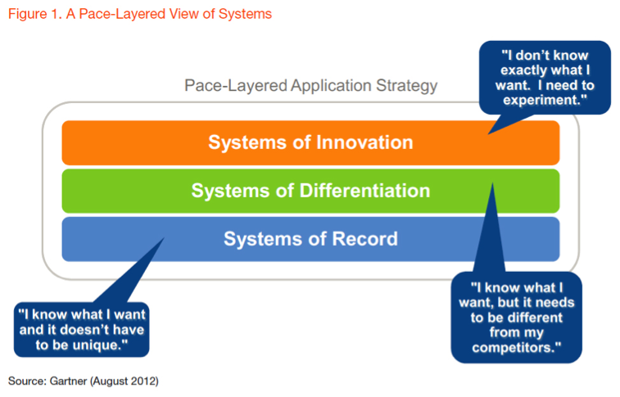
Digitalization – Agile Development – Standardisation?
Gartner’s Pace-Layered systems approach
Change
Individualisation
Standardization

Slide 14
Beispiel: Gliederung der Funktions-Ebenen im Fashion Retail
Digitalisierungs- und Integrations-Ebene
Partner- und Kundenintegration
Value Added APPs
Externe Services
Agil
Einfach Anpassbar
Interne Autonomie
Lizenzfrei
Branchen-Prozesse
Sportswear & Fashion Retail
Fashion-Matrix
Grössenlaufmgmt.
PDM Backbone
Saisonalität
Branchen-Standards
Branchen Best Practices
Anpassungen wo nötig
Industrielle
Warenwirtschaft
Beschaffung
Lager und Bestände
Warenbewegungen
Verrechnung/Bezahlung
Standard-Standard
Keine Anpassungen
Langfristig stabil
Betriebswirtschaftliche Buchungsmaschine
Buchhaltung
Buchungsbelege
Bewertungen
Abschlüsse

Slide 15
Finance
Product Data Mgmt.
Planning
Procurement
Logistics
Sales
Systems of Differentiation
Individual
Reporting
Merchandise (Strategic)
Purchasing Automation
Retail Store
Seasonal & Campaign planning
Procurement Planning
Stock availability Mgmt. -> Ring fencing
OTB Limits Planning
Wizard and automated support
Store Orders
Labeling
Store Inventory
Goods Receival
Theft etc.
Reporting Front End
Treasury
Incoming Goods Handling (extended)
Currencies & Treasury
Cash Management
Pricing Engine
Identifying
Labeling
Conditioning
Merchandise (Strategic)
POS
Invoice Matching
Stock availability Mgmt. -> Ring fencing
Warehouse Mgmt.
Lean LVS (ERP Integrated)
Industry template
Payment Matching
PIM
Product Lifecycle Mgmt.
Settlement Reconciliation
Product Meta Data Mgmt.
(Bundle Recommendation Mgmt.)
Product Creation Workflow & Automation
Product Placement and Merchandise Lifecycle
Delivery Management Retrieving Logic
Stock Management
Logistics Product Labelling
Loyalty Valuation
Merchandise (Operational)
Financial valuation of loyalty accounts
Product Allocation
Ring fencing
Retail Store
Replenishment
Exception & Backlog Mgmt.
Store Master Data
Store Delivery Calendar
Stock Taking System
Financial Planning
Extended Item Data Mgmt.
Order Fulfillment
Forecasting & Budgeting
Fashion Matrix Structure
Structure Products
Customs Tariffs
Fulfillment Order Allocation
Exception Management
Fulfillment Order Tracking
Systems of Record
ERP Standard
Finance
Item Data Mgmt.
Product Lifecycle Mgmt.
Purchasing Basics
Inventory Management
General Ledger
- Closings (HGB & IFRS)
- Governmental Reporting
Localization & Fiscalization
Legal Reporting / Taxes
Compliance
Accounts (receivables / payables)
Payments & Settlements
Identifier
Item Master Data exchange
Hierarchies
Stock availability Mgmt. -> Ring fencing
Supplier Mgmt.
Sourcing direct goods
Sourcing indirect goods
Purchase Order Mgmt.
OTB Limits actual
Central Stock Keeping
Retail Stock Keeping
Vendor Mgmt. Inventory
Order Fulfillment
Incoming Goods Handling
Stock Availability
Returns Management
Inventory Valuation
Shipment Receival
Goods Receiving
Order Matching
Exception Mgmt.
Stock (physical & virtual)
Stock valuation
Customs Mgmt. (out)
Cost Accounting
Customs Mgmt. (in)
Internal
Margin Calculation
Cost Analysis
KPI (raw data)
Beispiel: Funktionaler Bebauungsplan im Gartner Pace Layered Model
Commercial Booking Logic
Business Case Repository
Booking Logic
Organization Mgmt.
ERP
Legal entities
Intercompany Relations
Intercompany Pricing
ERP tbd
Non-ERP

